Slide 1
The key role of transaction fees in the viability of blockchain technology for audit applications
48th World Continuous Auditing and Reporting Symposium
Juan Jesús Rico, Raquel Arguedas, Carmen López
Universidad Nacional de Educación a Distancia (UNED)
25th September 2020

Slide 2
Blockchain, a suitable technology to audit processes
Since its inception beginning 2009, blockchain technology has shown to be very robust.
Expansion to a wide rage of domains, bringing benefits to different sectors.
Intrinsic characteristics: transparency, autonomy, decentralization, immutability.
Blockchain seems particularly suitable to audit processes:
Capability to record information in a secure way.
Costless digital verification.
Privacy of the entities involved.
25th Sept. 2020
48 WCARS - The key role of transaction fees in the viability of blockchain technology for audit applications»
Page 2
Notes:
.

Slide 3
Sustainability of the model in the long-term
Blockchain is a promising technology, but not without threats.
A relevant concern, particularly for the public permissionless blockchain apps., is the funding of participants (network nodes, miners).
The system stability/security rely on the number of participants.
In the long-run, the main income for them will be the transaction fees.
Stability is a must for audit.
Fees should remain competitive, so that making blockchain useable.
Both parameters (fees & stability) are directly linked.
25th Sept. 2020
48 WCARS - The key role of transaction fees in the viability of blockchain technology for audit applications»
Page 3

Slide 4
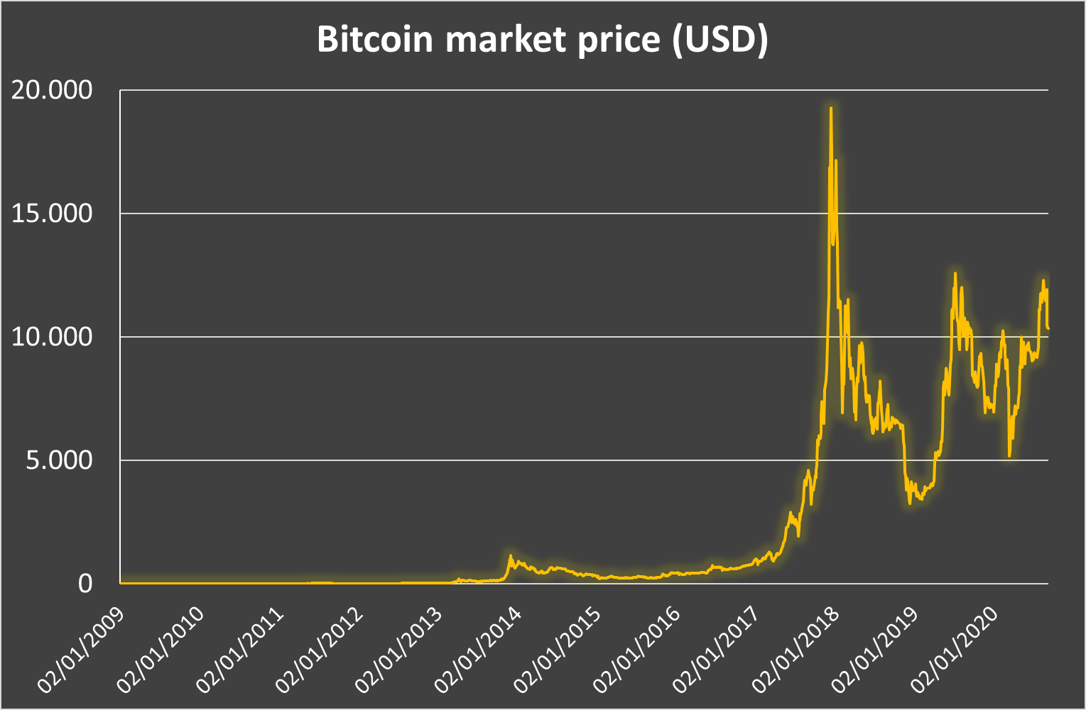
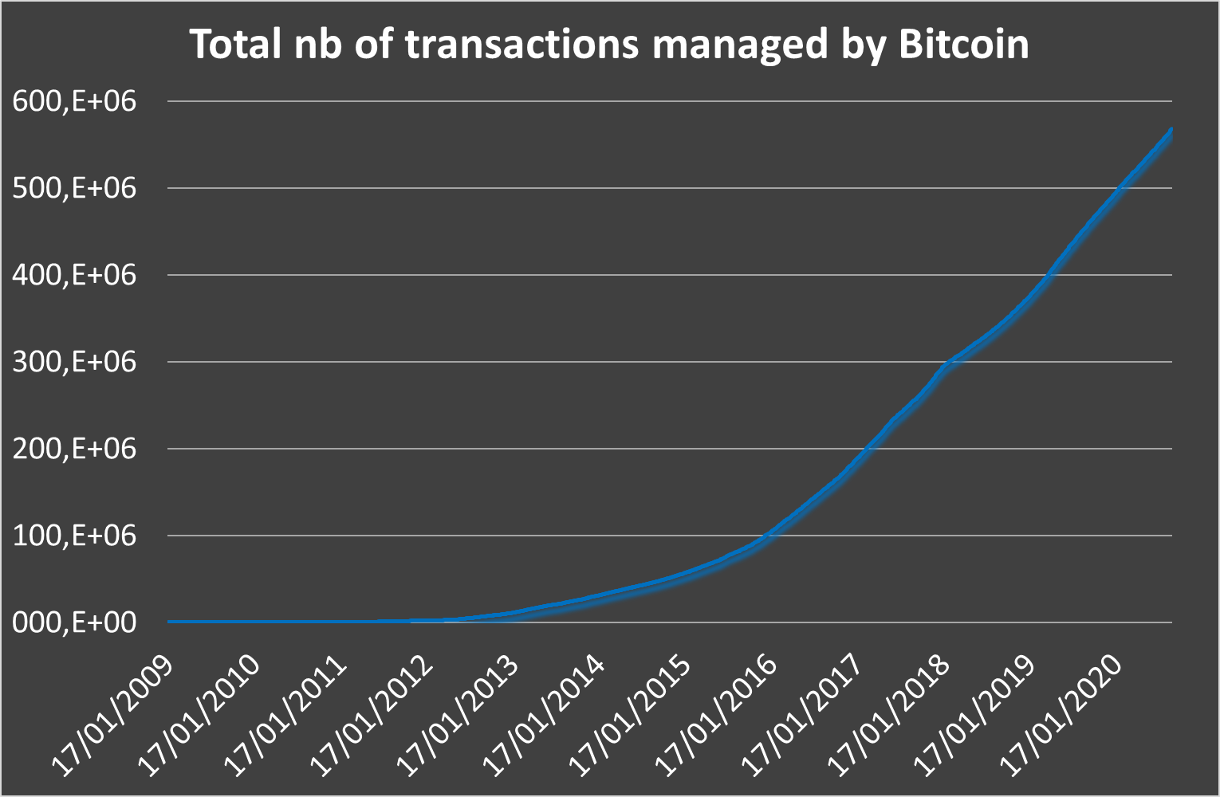
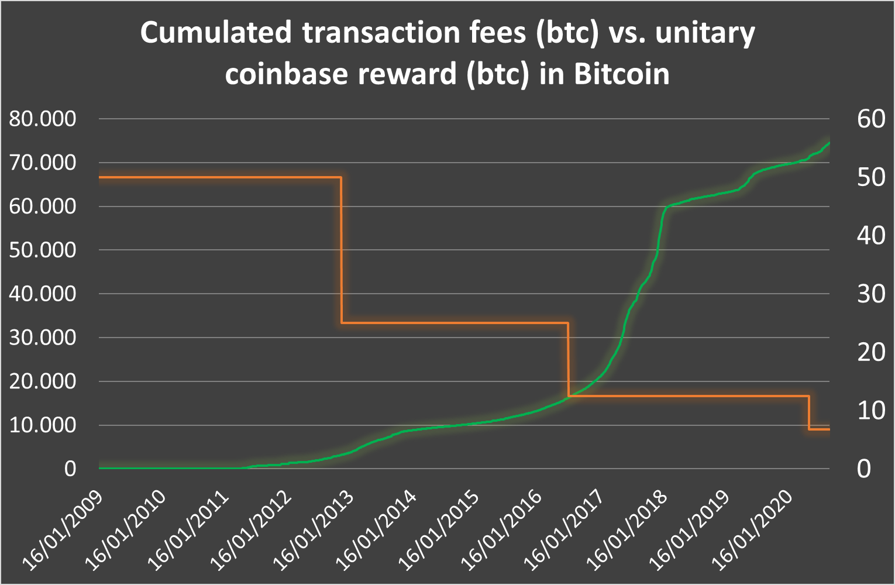
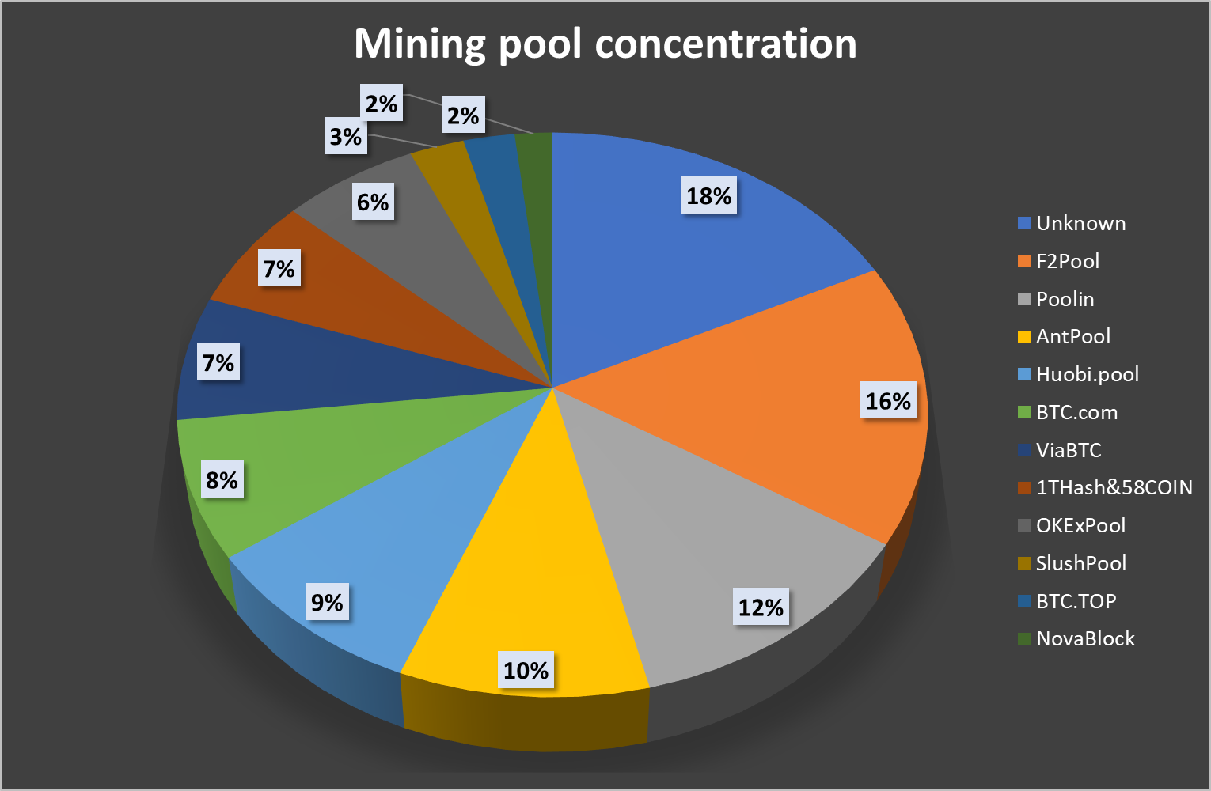
23th April 2020
48 WCARS - The key role of transaction fees in the viability of blockchain technology for audit applications»
Page 4
Prepared by the authors based on data from https://www.blockchain.com/es/charts, retrieved mid-September 2020.

Slide 5
23th April 2020
48 WCARS - The key role of transaction fees in the viability of blockchain technology for audit applications»
Page 5
Prepared by the authors based on data from https://www.blockchain.com/es/charts, retrieved mid-September 2020.

Slide 6
23th April 2020
48 WCARS - The key role of transaction fees in the viability of blockchain technology for audit applications»
Page 6
Prepared by the authors based on data from https://www.blockchain.com/es/charts, retrieved mid-September 2020.

Slide 7
23th April 2020
48 WCARS - The key role of transaction fees in the viability of blockchain technology for audit applications»
Page 7
Prepared by the authors based on data from https://www.blockchain.com/es/charts, retrieved mid-September 2020.

Slide 8
23th April 2020
48 WCARS - The key role of transaction fees in the viability of blockchain technology for audit applications»
Page 8
Prepared by the authors based on data from https://www.blockchain.com/es/charts, retrieved mid-September 2020.

Slide 9
Trends
Even though the problem is identified, today the most relevant blockchain applications do not actively manage the transaction fees.
Seems to be a consensus on the need for updating the current fee-setting rules.
Different alternatives are being proposed.
Some time before the impacts could arise.
In the meantime, the evolution of the number applications and users using blockchain will be a key factor to get an idea of its future availability.
25th Sept. 2020
48 WCARS - The key role of transaction fees in the viability of blockchain technology for audit applications»
Page 9

Slide 10
Conclusions
Blockchain has shown to be a reliable technology, able to provide efficient solutions to different domains besides cryptocurrencies.
Blockchain is able to fit the requirements to record audit information.
Concerns on the future evolution of fees, directly linked to the security of the system.
Before using this technology for audit a detailed analysis is to be performed, considering advantages & drawbacks of alternative implementations.
25th Sept. 2020
48 WCARS - The key role of transaction fees in the viability of blockchain technology for audit applications»
Page 10

Slide 11
Thank you!
We are at your disposal for any information, clarification you may require.
25th Sept. 2020
48 WCARS - The key role of transaction fees in the viability of blockchain technology for audit applications»
Page 11

